Slide 1


Web Application for Tracking Scrum Projects
Luke Thompson

Slide 2
Introduction
Software tool for Scrum projects
Focuses on three areas of Scrum
Sprint Planning
Sprint Execution
Standup
Retrospectives

Slide 3
About Scrum
Different roles
Scrum Master
Product Owner
Team
Events
Sprint Planning
Retrospective
Standup
Sprint Review

Slide 4
Requirements
User and account management completed
Rich tickets, categorizable and prioritizable completed
Revision history completed
Sprint Planning completed
Sprint Tooling
Sprint board completed
Standup mode completed
Retrospectives (graphs, comments) completed
Sprint Forecasting not implemented

Slide 5
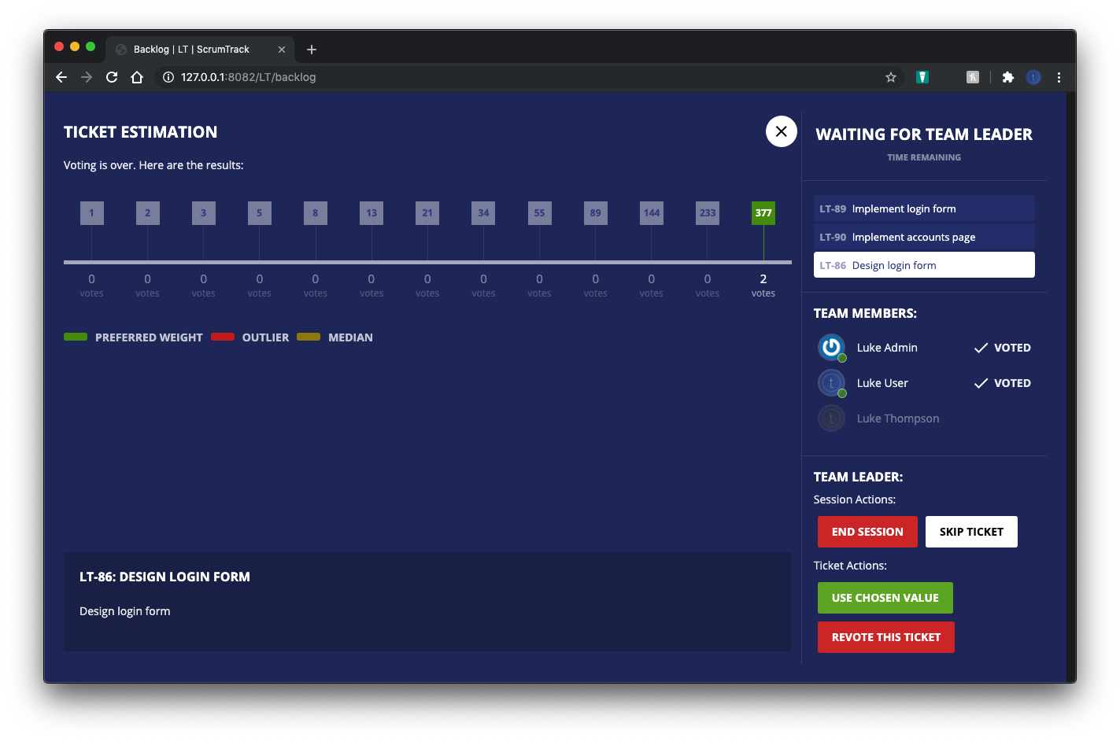
Sprint Planning
Team, interactive sprint planning
Automatic resolution to a degree
Lead by a scrum master

Slide 6
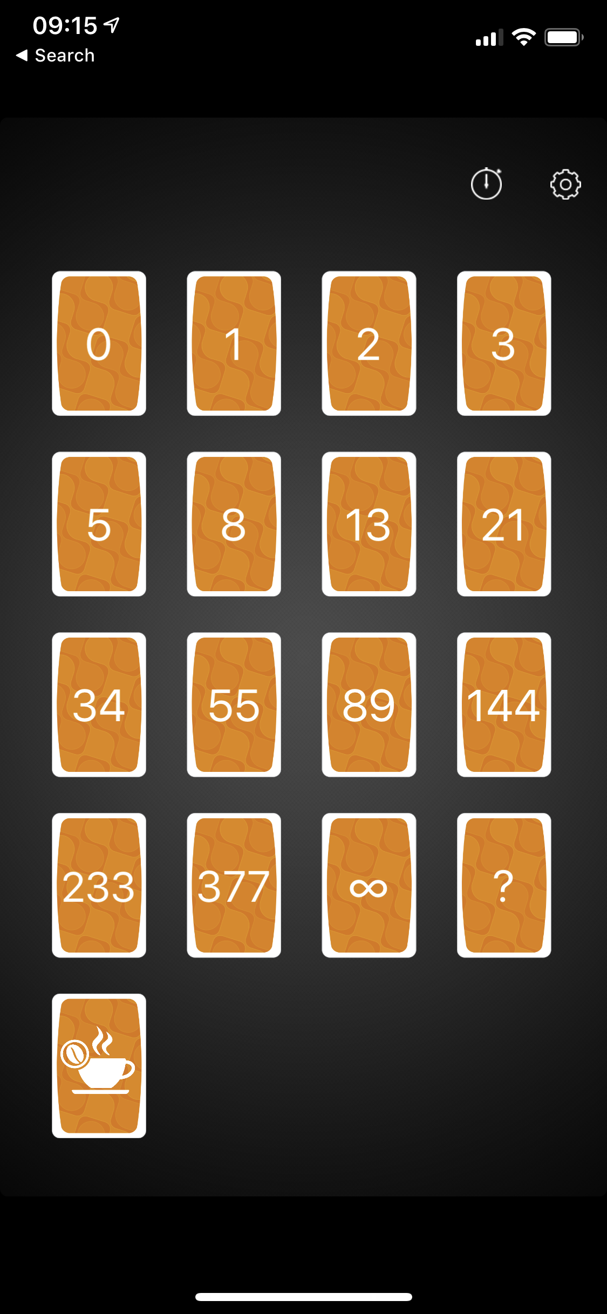
Sprint Planning – example of existing
Existing tools are clunky to use.
Require manual aggregation and calculation

Slide 7
Sprint Planning
Problem around automatic calculation, but not taking control away from the team.

Slide 8
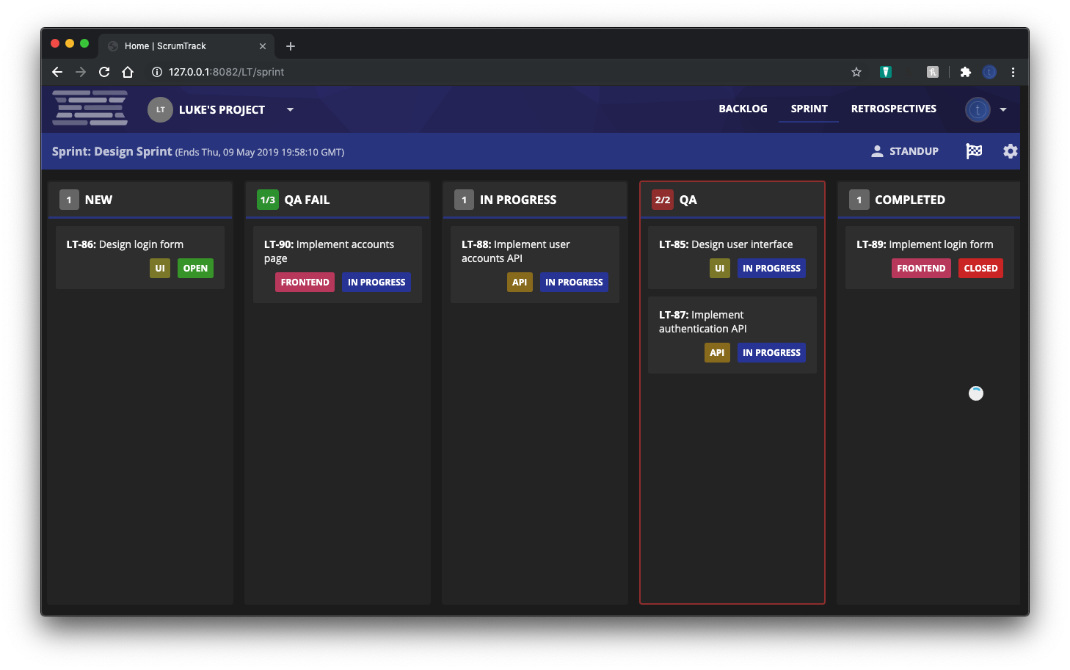
Sprint Execution
Displays an overview of current sprint
Kan-ban style with workflows for simple use
Customizable, but simple to use

Slide 9
Standup Mode
Displays tickets changed in the last 24h
Daily standup is an event where what’s been completed is discussed

Slide 10
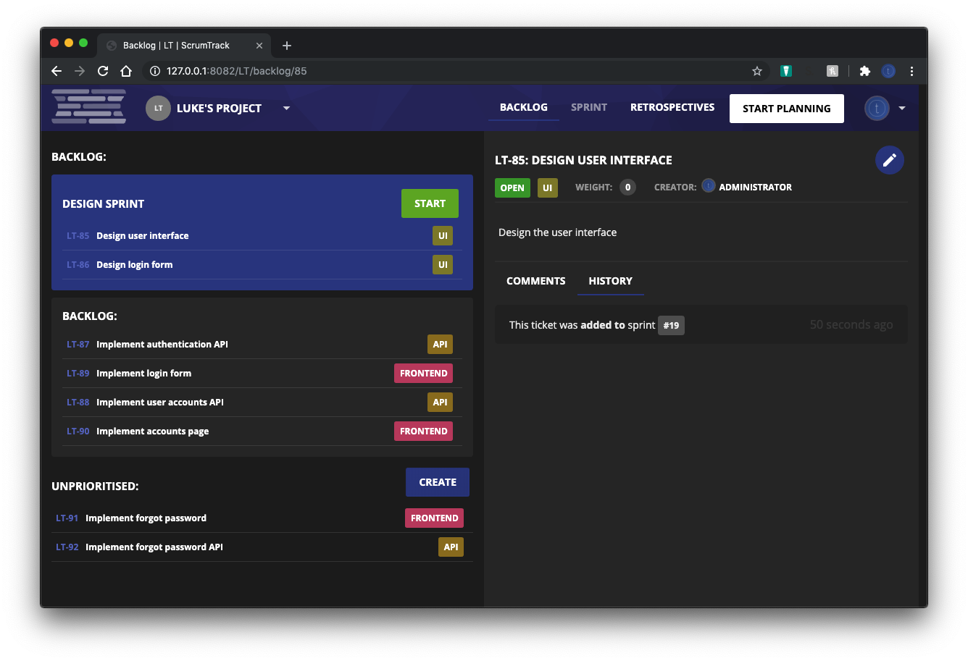
Ticket Management
Overview of all tickets
Aids backlog prioritisation
Ordered backlog
Unordered pending area for new tickets

Slide 11
Retrospectives
Various charts to display past sprint
Discussion on the last sprint, good and bad
Log of all the tickets opened, added and closed.

Slide 12
Implementation
Interface in React (javascript)
Sprint planning in NodeJS w/ websockets
Remainder in Go, with a MySQL database.
React frontend
API Router
Planning server
Go API and domain services

Slide 13
Reflection
Tools are moving in this direction (within the last yr)
Expansion into other areas would be required for it to be viable for real-world use

